Slide 1
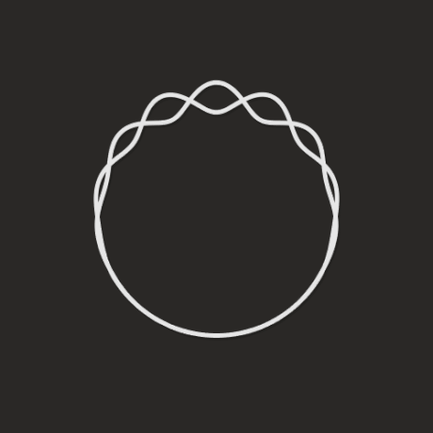
Fourier Series

Slide 2
Overview
Introduction
History
Graphs
Circle Representation
Functions Using Fourier Series
Applications of Fourier Series

Slide 3
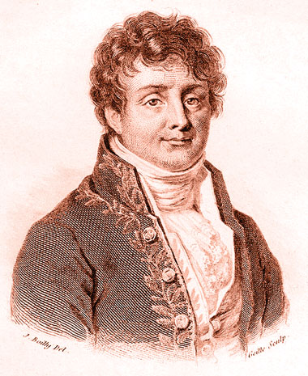
Joseph Fourier [1768-1830]

Slide 4
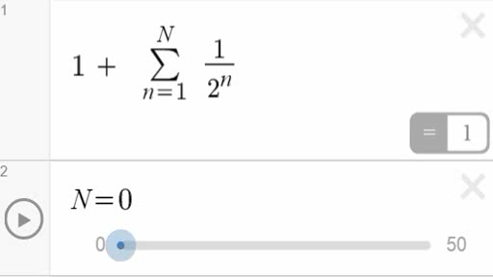

Introduction
$$1+\frac{1}{2}+\frac{1}{4}+\frac{1}{8}+\frac{1}{16}+…=2$$

Slide 5


$f\left(x\right)=sinx+\frac{sin2x}{2}+\frac{sin3x}{3}+\frac{sin4x}{4}+…$
Continuous Function
$f(x)$
Converges to
Discontinuous Function
$$\frac{1}{2}\lim_{x→c}\left(f\left(x^{+}\right)+f(x^{−}\right))$$

Slide 6

Fourier Series is a way of representing a function as an infinite sum of its fundamentals and harmonics.
$$f\left(x\right)=a_{0}+\sum_{n=1}^{∞}{\left(a_{n}\cos{\frac{nπx}{L}}+b_{n}\sin{\frac{nπx}{L}}\right)}$$
Fundamental
Harmonics

Slide 7
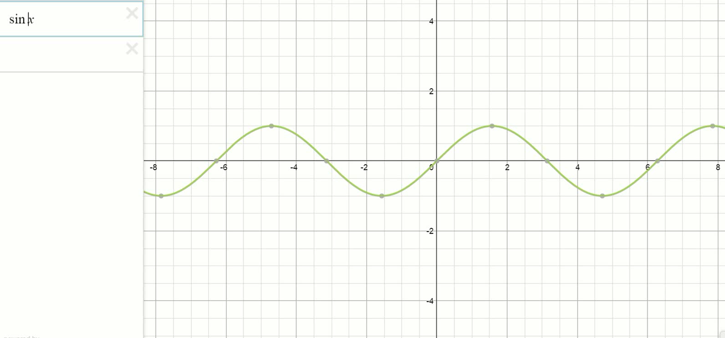
Graphs

Slide 8
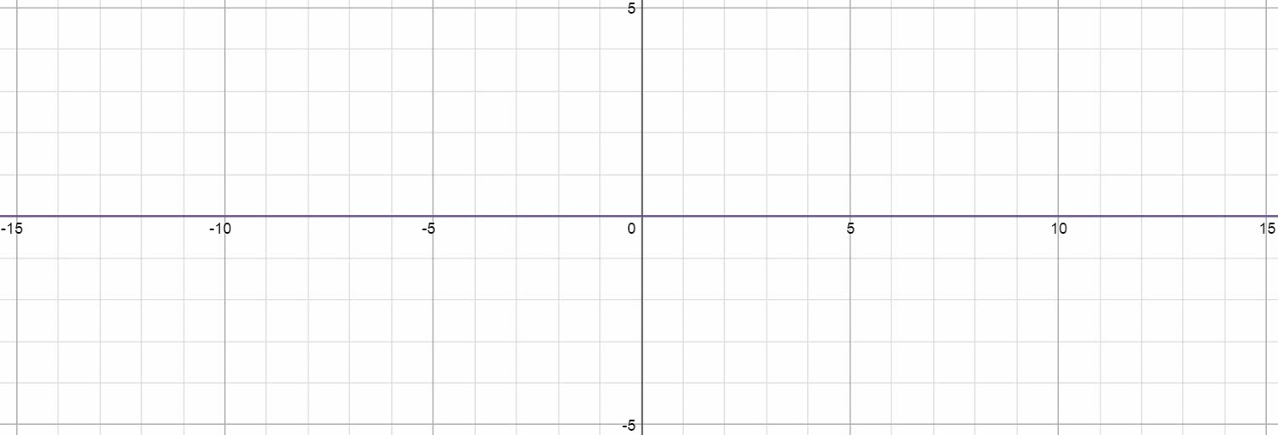
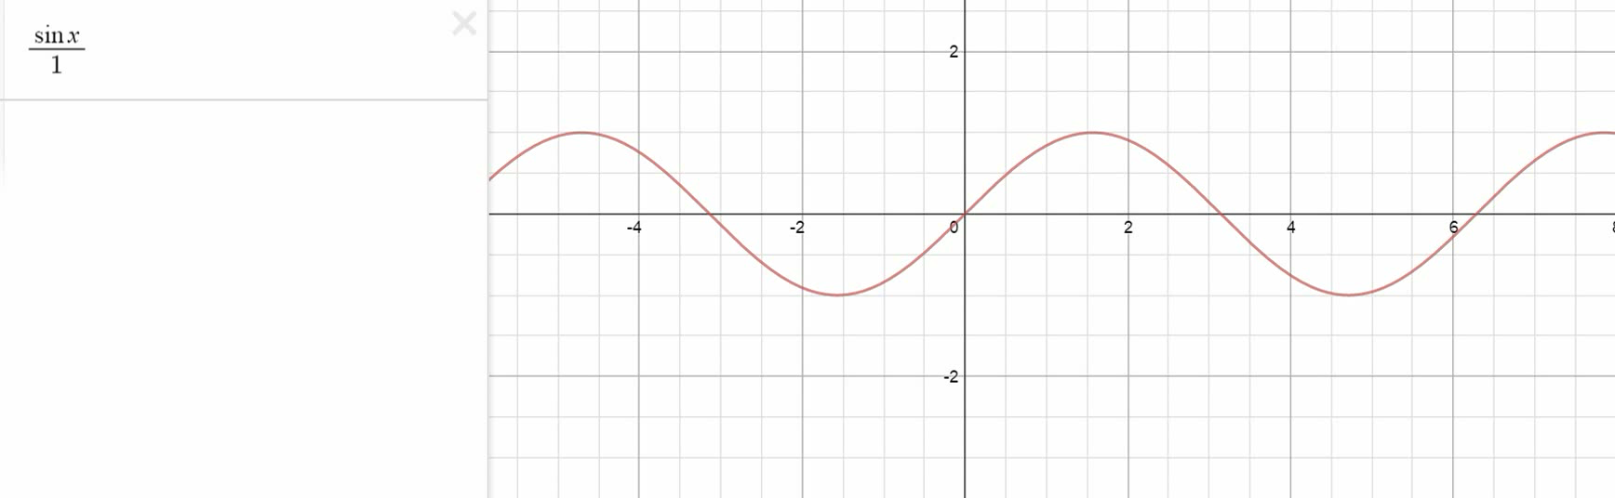
Graphs

Slide 9
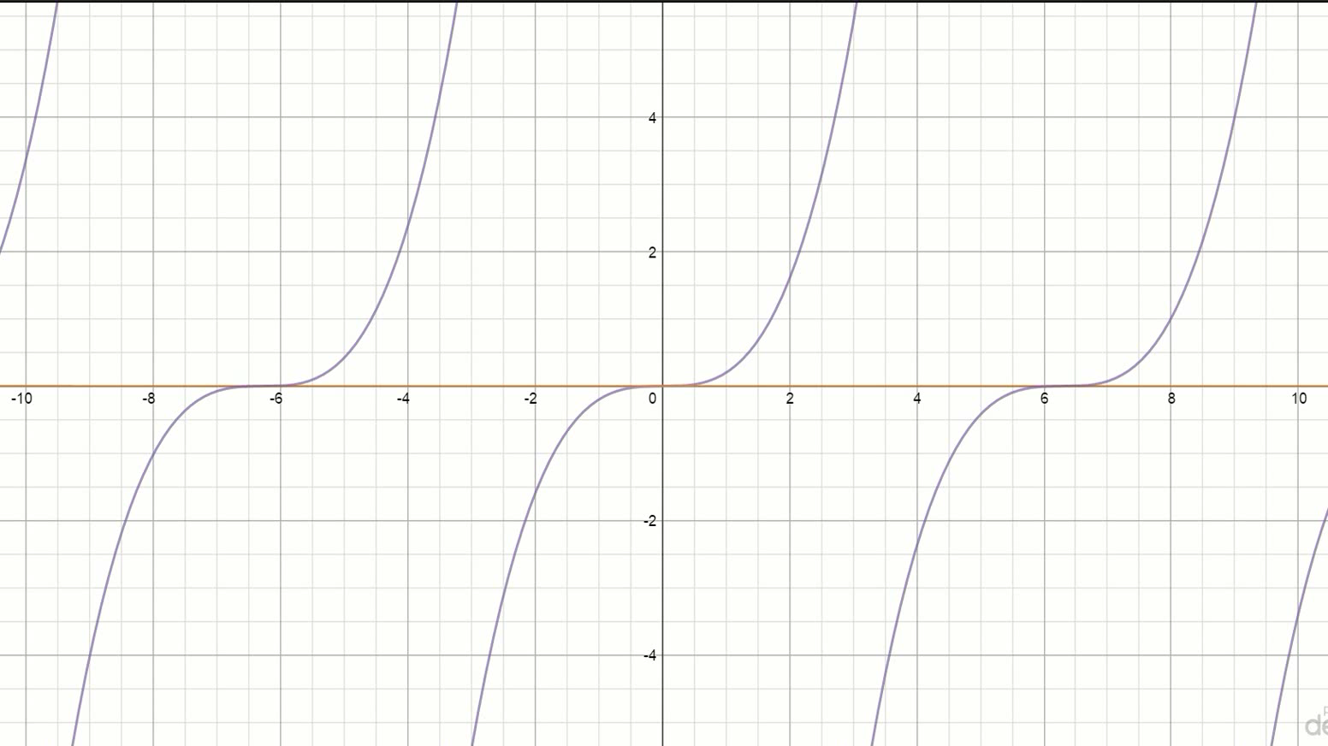

$$\frac{{ x}^{3}}{5}$$

Slide 10
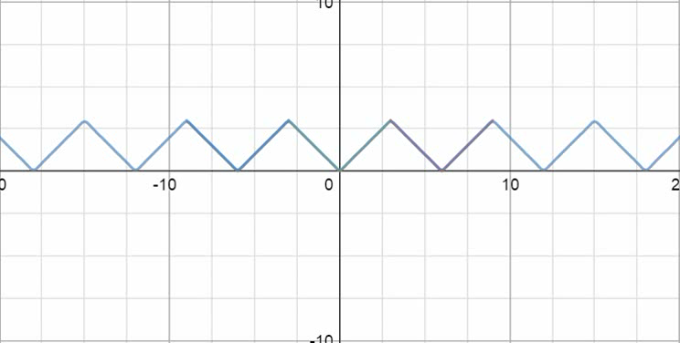
Approximation

Slide 11
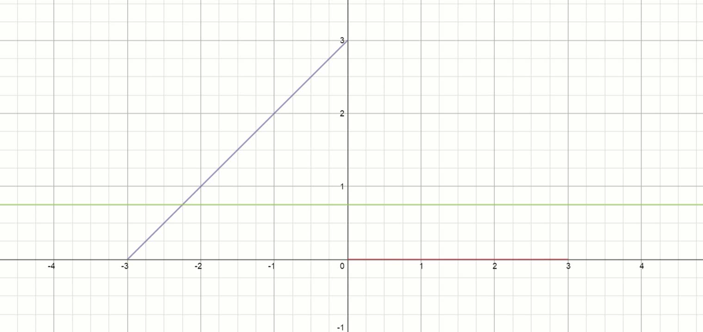
Discontinuous Functions

Slide 12
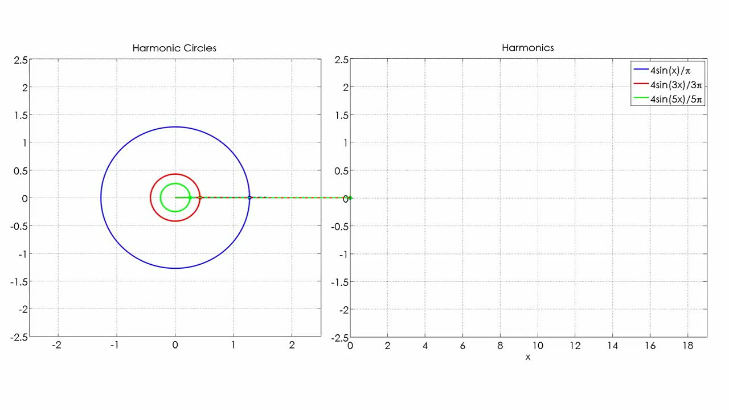
Circle Representation

Slide 13
Dirichlet Conditions
The particular conditions that a function f(x) must fulfil in order that it may be expanded as a Fourier series are
The function must be periodic;
It must be single-valued and continuous;
It must have only a finite number of maxima and minima within one periodic;
The integral over one period of |f(x)| must converge.

Slide 14
Applications
.mp3
Signals Processing
Advanced noise cancellation
Solutions Partial Differential Equations
Cryptography
Optics
DNA Sequencing

Slide 15
